Slide 1

Call Routing System In Call Center
GROUP NO 16
Vishal Garg -201612064
Dip Halani -201612012
Savan Luhar -201612081
Riddhi Patel -201612044
Aastha Dwivedi -201612082
Group mentor- Harshit Shah

Slide 2


Index
Project Profile
Diagram
System Requirement and Specification
Future Scope
Data Structure

Slide 3
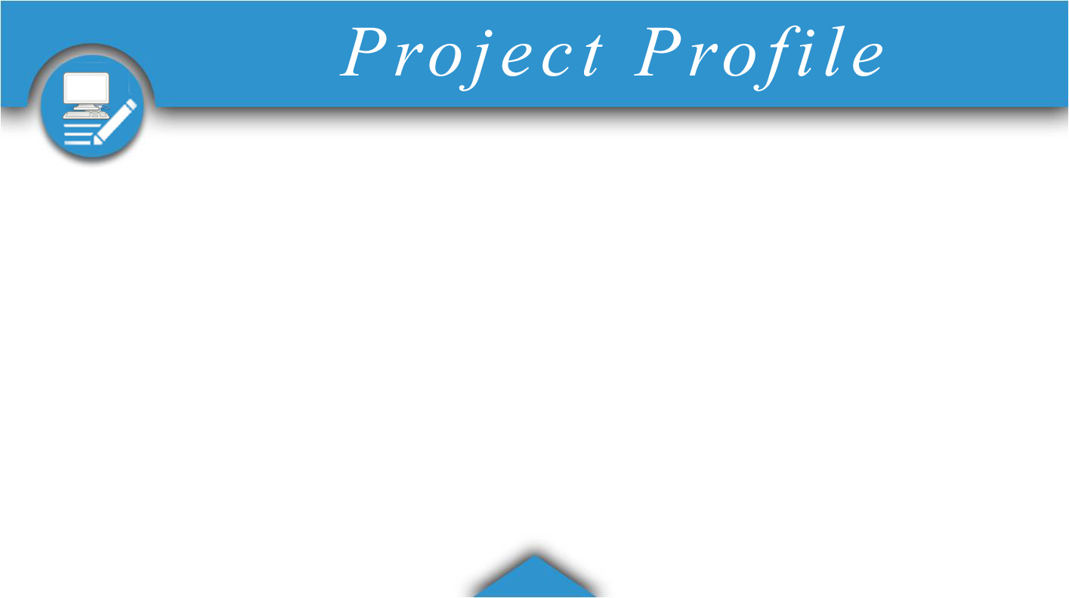
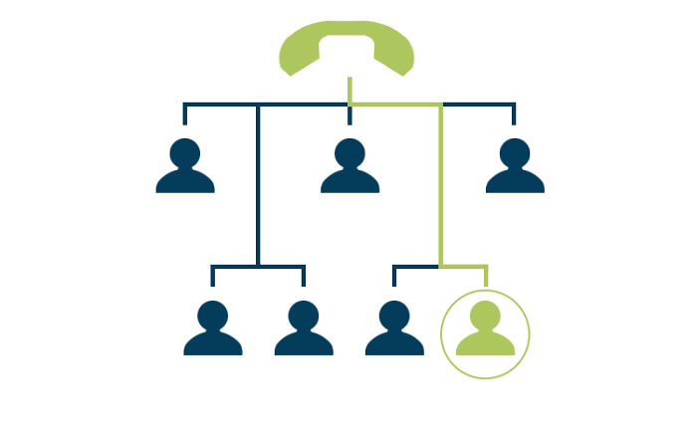
Project Definition
Call routing system also known as automatic call distributor(ACD) is used to rout calls to agents working in agencies. This system uses queues to place calls to various agents based on various factors such as language, order of arrival and vacancy of the agents. Caller will have options based on language available. If the agents of that particular language are available to the caller then call will be dispatch to one of those agents.

Slide 4
Purpose of the project
To learn the implementation of data structure, algorithms and object oriented concepts in real life projects.

Slide 5
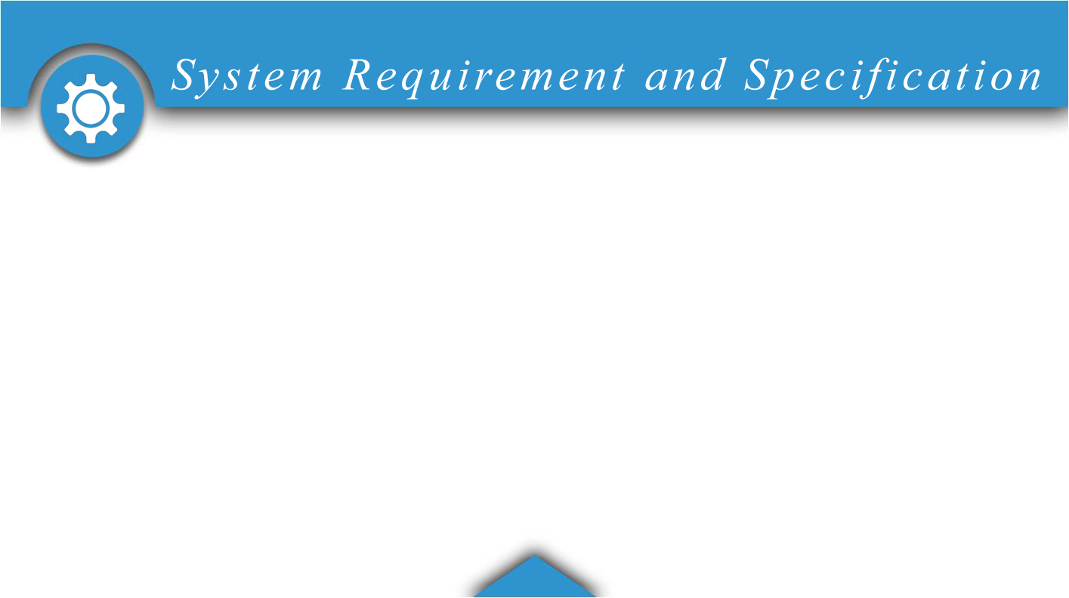
Software Requirement
Web Browser(Preferably chrome)
Web server
Apache Tomcat
Front-end Technology
JSP-Servlet
Materialize CSS
Front-end Tools
Eclipse

Slide 6
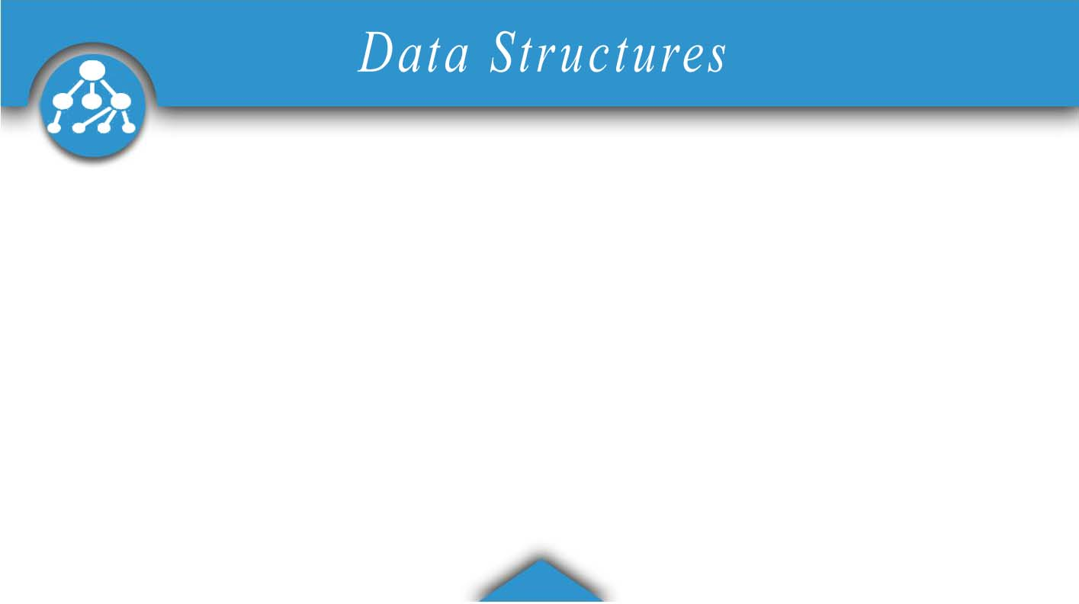
Data structures
Queue
ArrayList
HashMap
Queue
ArrayList
Hashmap

Slide 7
Other Concepts Used
Thread
OOP approach

Slide 8
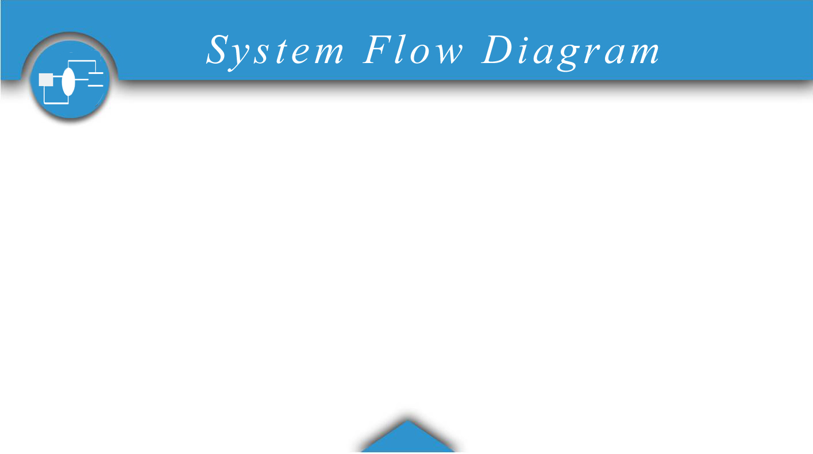

Slide 9

Optimizing Algorithm
Disconnecting waiting call automatically after fixed time

Slide 10


Slide 11


